Slide 1
Advanced Design Scripting & Parametrics – Class 07 – Meshes and BREPs

Slide 2
Today – key concepts
Meshes
Boundary Representations (BREPS)
Surface curvature if we have time

Slide 3
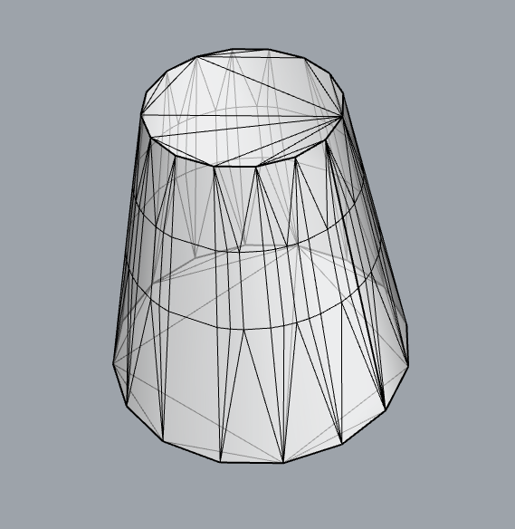
Meshes
Meshes are collections of triangles (and sometimes “quads”), assembled into contiguous closed or open configurations.
Several triangles can share a common vertex, so there are efficient ways of making these references between triangles and vertices.
Vertices can have additional information, including:
Color
Effective normal
Positioning in 2D texture space

Slide 4
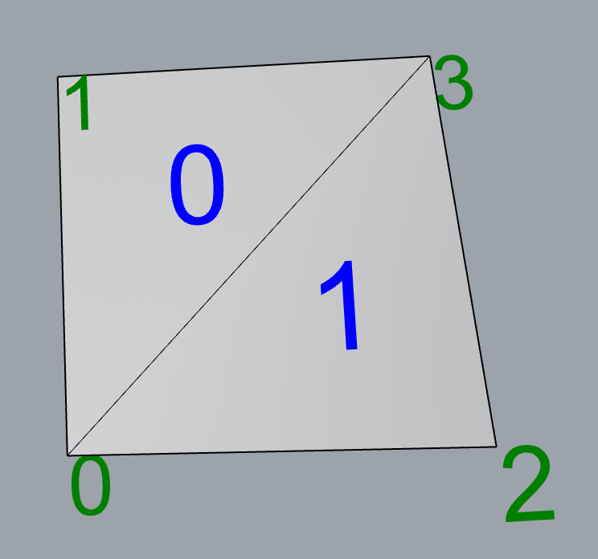
Mesh elements
Comprised of:
Vertices – each has:
an index (integer) corresponding to its index in the vertex array
and optionally:
A normal (Vector3f)
A texture coordinate (Point2f)
A color (Color)
Faces - each has
4 vertex indices A, B, C, D (integers), where the C and D can be duplicates can be duplicates
An implied surface normal (Vector3f), with a direction “pointing out” defined by the cross product of the vectors AB and BC
Edges – implied, which can be:
Internal
“Naked”
Non-manifold

Slide 5
Mesh elements
A mesh can be:
Open
Closed
Non-manifold (almost never is)

Slide 6
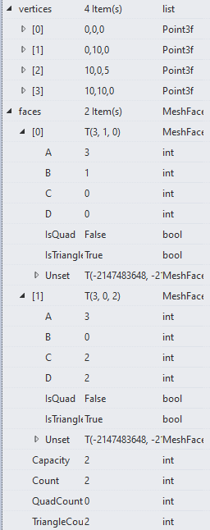
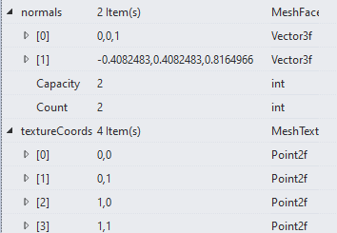
AnalyzeMesh.py

Slide 7
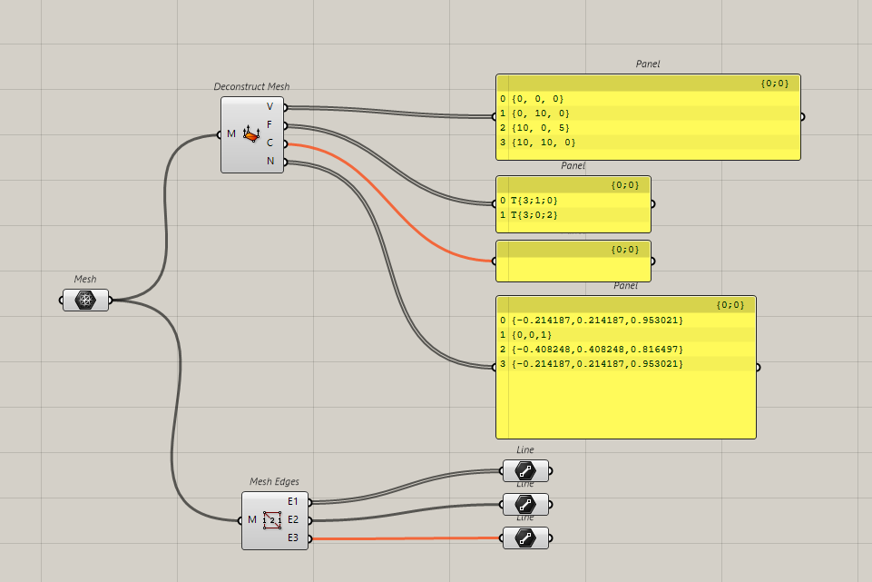
AnalyzeMesh.gh

Slide 8
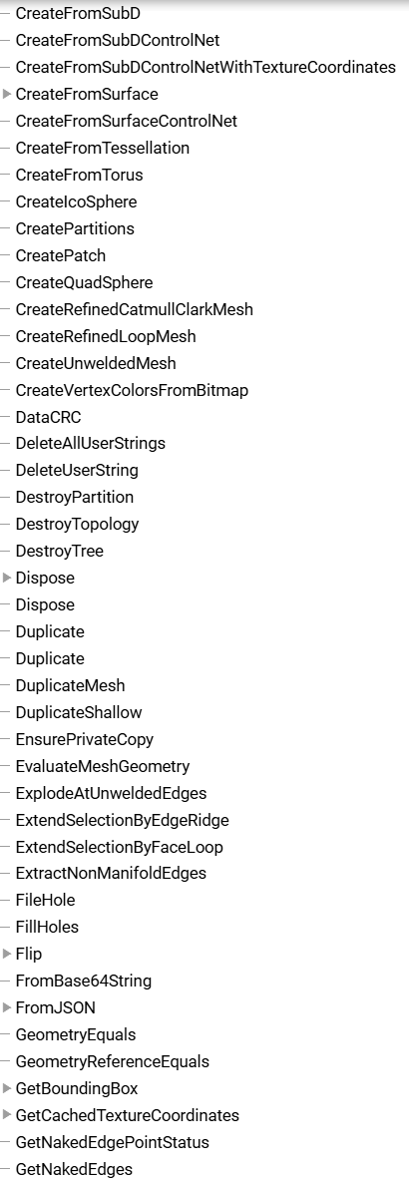
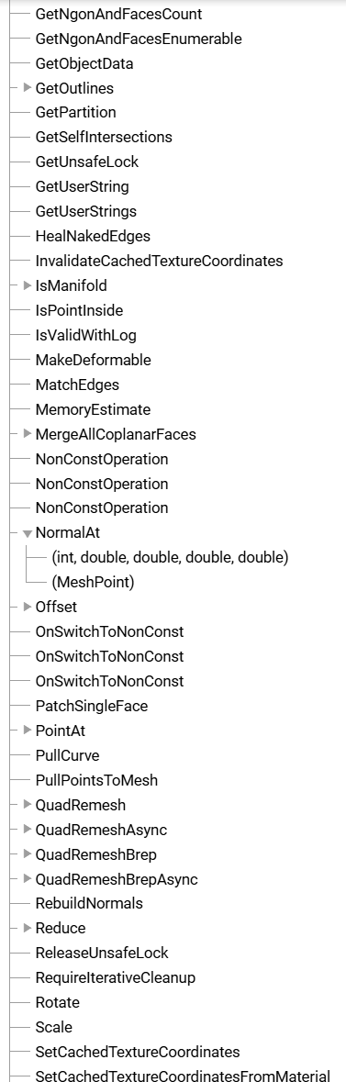
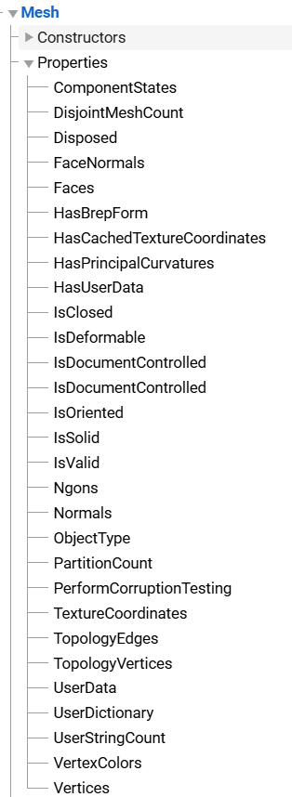
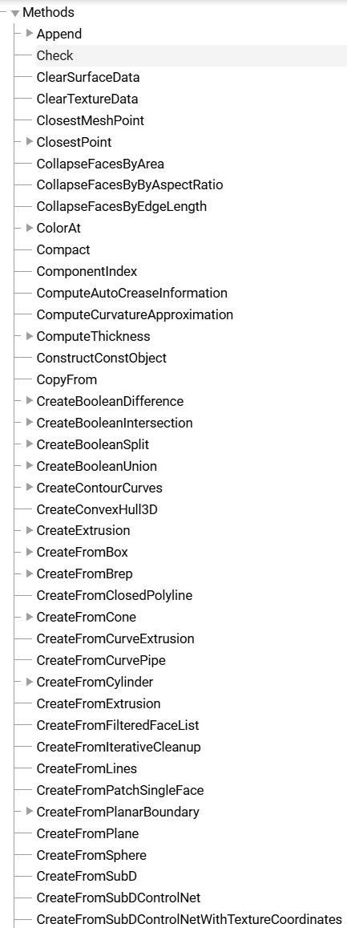
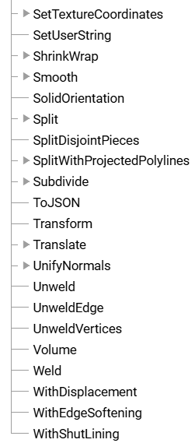

Slide 9
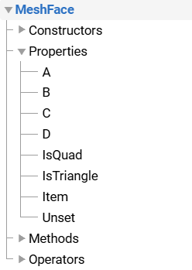
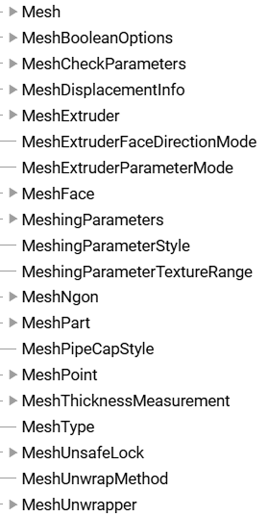
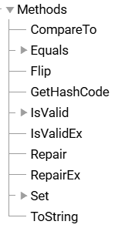

Mesh Geometries

Slide 10
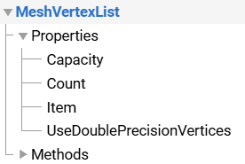
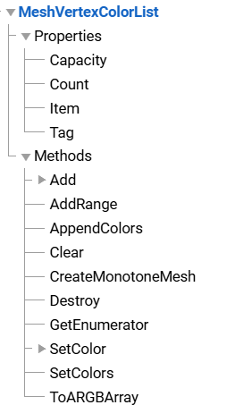
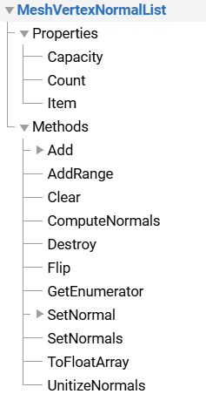
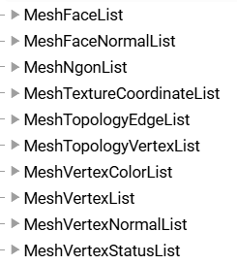
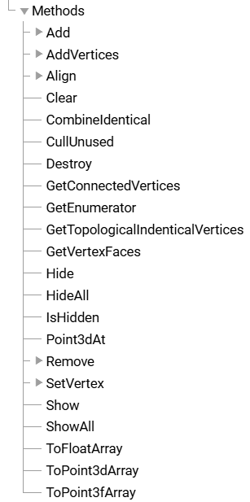
Mesh Collections
Point3f
Color
Vector3f

Slide 11
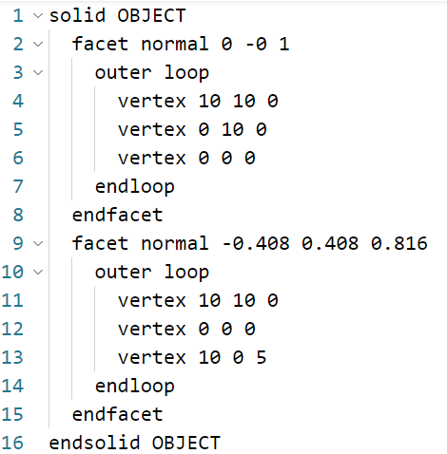
STL Definition (“normal” – zero ordered)
.STL file

Slide 12
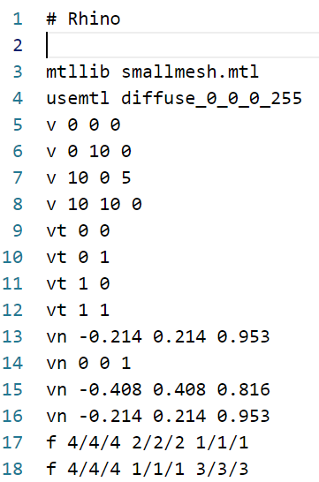
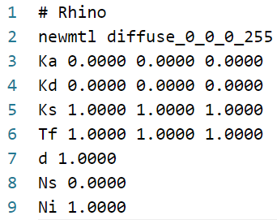
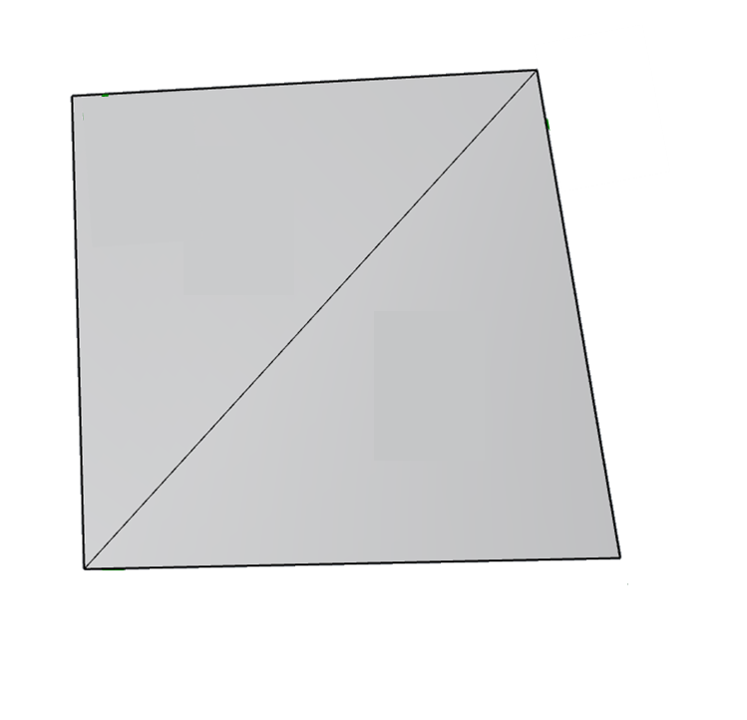
OBJ Definition (“1 Ordered”)
.OBJ file
.MTL file
4
2
1
vertices
2
texture
1
3
normals
faces
v
t
n

Slide 13
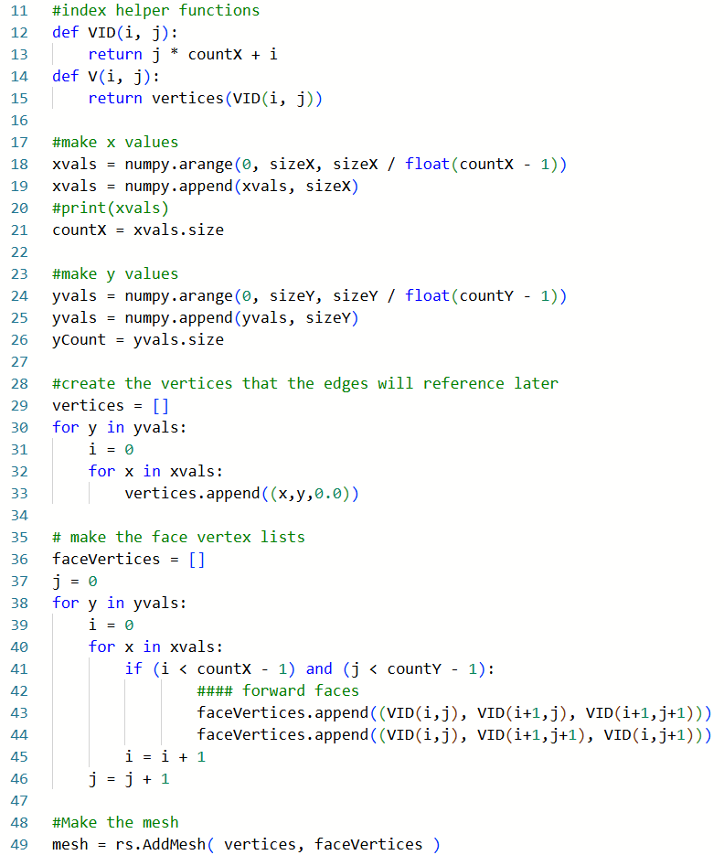
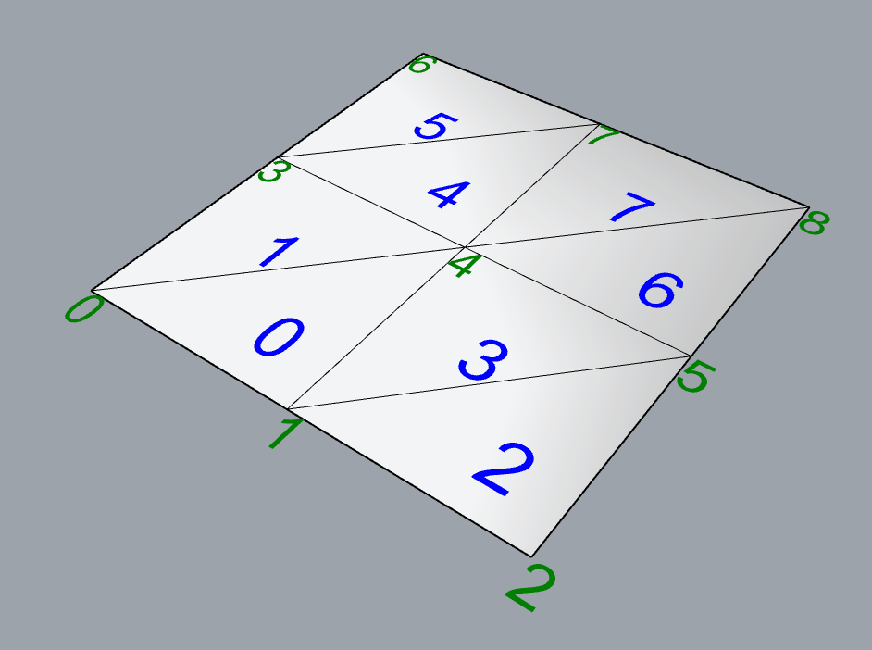
Making a mesh (makeMesh01.gh)
index
ranges
vertices
faces
mesh

Slide 14
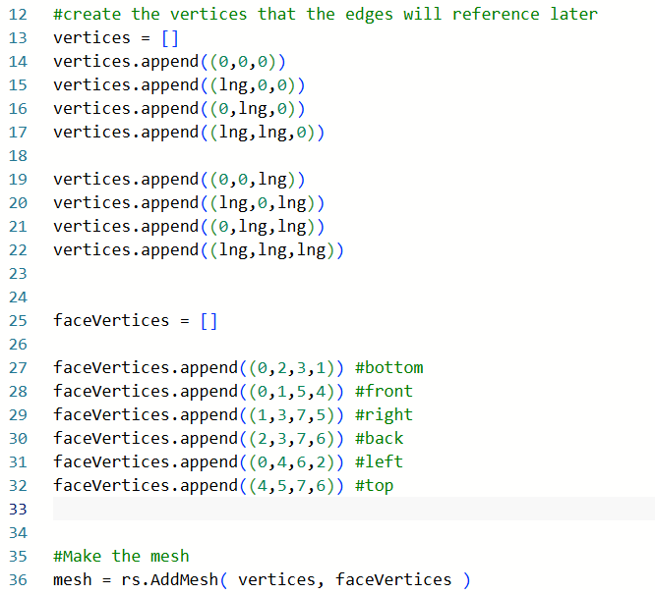
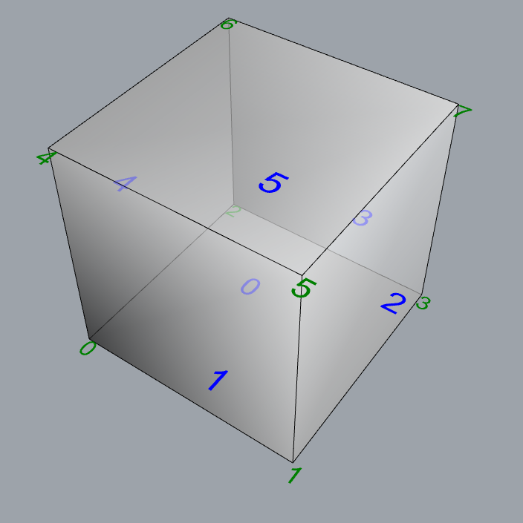
Making a cube (makeMesh04 – cube)

Slide 15
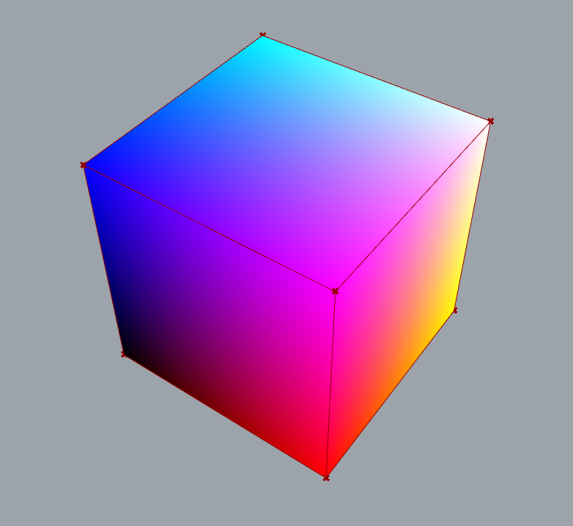
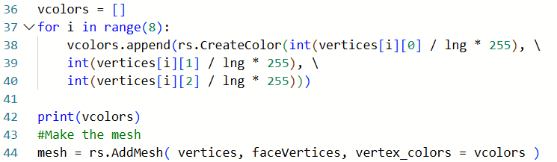
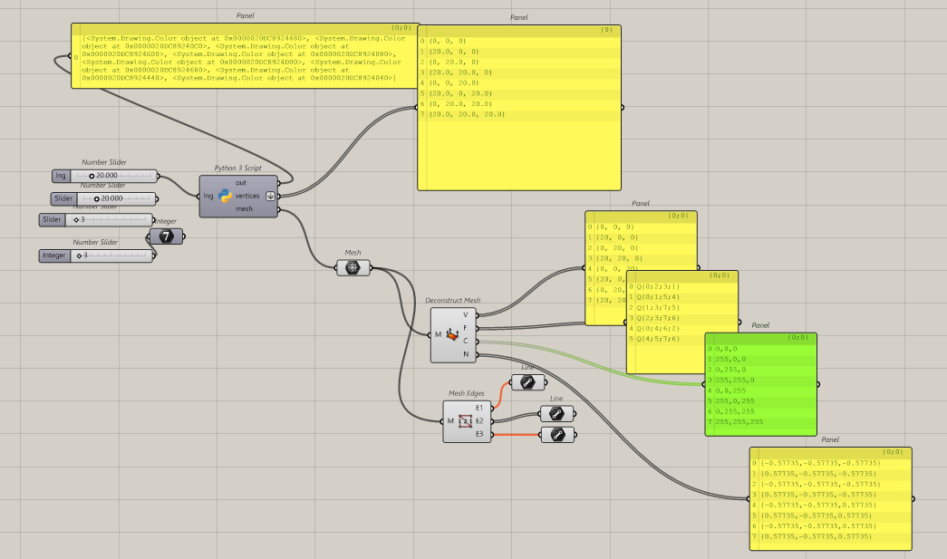
Making a cube with colors (makeMesh05 – cube)

Slide 16
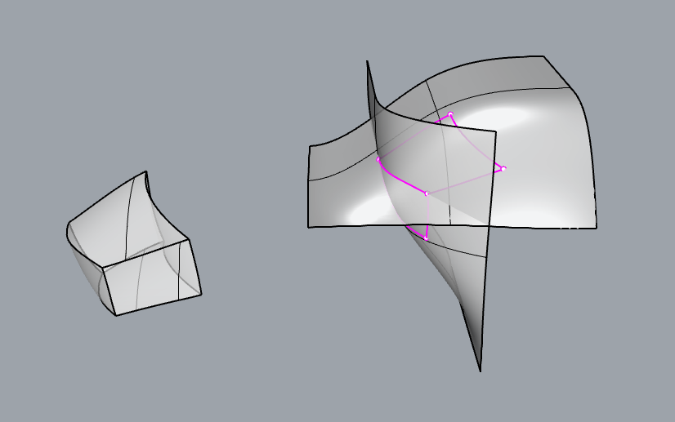
BREPs (Boundary Representations)
BREPs are collections of trimmed or untrimmed NURBS surfaces,
that are connected into open or closed objects.
In Rhino, Solids are closed BREPS

Slide 17
BREPs (Boundary Representations)
Polysurface (BREP)
Face
Surface
Edges
Curve3d
Edges
Curve2d
Face
Surface
Edges
Curve3d
Edges
Curve2d

